Slide 1
Generics in Java Collection API
Session 9
Notes:
1

Slide 2
Objectives
Introduction to generic
Generic class
Generic method
Introduction to java.util Packages
Lists
Sets
Maps

Slide 3
Introduction to Generic
The Java Generics programming is introduced in J2SE 5 to deal with type-safe objects.
Before generics, we can store any type of objects in collection i.e. non-generic. Now generics, forces the java programmer to store specific type of objects.

Slide 4
Advantages of Java Generics
Type-safety : We can hold only a single type of objects in generics. It doesn’t allow to store other objects.
Type casting is not required: There is no need to typecast the object.
Compile-Time Checking: It is checked at compile time so problem will not occur at runtime. The good programming strategy says it is far better to handle the problem at compile time than runtime.

Slide 5
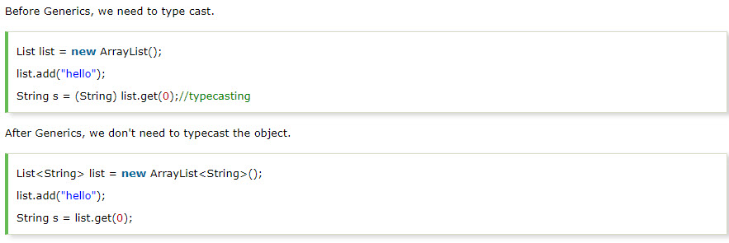
Example

Slide 6
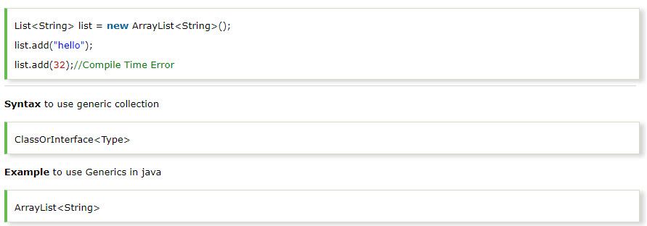
Example

Slide 7


Creating Generic Classes
Generics enable you to generalize classes.
In the declaration of a generic class, the name of the class is followed by a type parameter section.
The type parameter section is represented by angular brackets, < >, that can have one or more types of parameters separated by commas.
The following syntax is used to create generic classes:
class [ClassName]<T>
{
}
You can create a generic class by using the following code snippet:
class GenericClassDemo<T>
{
}

Slide 8
Creating Generic Classes (Contd.)
In case you want to create a generic class to set and get the Integer and String values, you can use the following code:
public class GenericClassDemo<T>
{
private T t;
public void setValue(T t)
{
this.t = t;
}
public T getValue()
{
return t;
}

Slide 9
Creating Generic Classes (Contd.)
public static void main(String[] args)
{
GenericClassDemo<Integer> iobj = new GenericClassDemo<Integer>();
iobj.setValue(10);
System.out.println(iobj.getValue());
GenericClassDemo<String> sobj = new GenericClassDemo<String>();
sobj.setValue("Ten");
System.out.println(sobj.getValue());
}
}

Slide 10
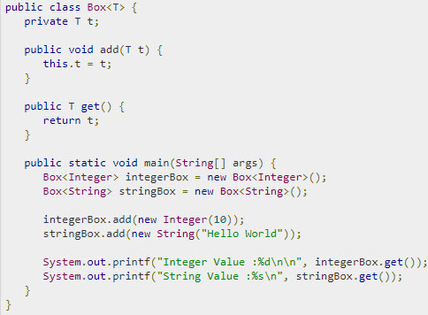
Demo generic class

Slide 11
Creating a Generic Method
In the generic class, a method can use the type parameter of the class, which automatically makes the method generic.
Consider the following code of the generic method inside the generic class:
public class GenericClassDemo<T>
{
private T t;
public void setValue(T t)
{
this.t = t;
}
public T getValue()
{
return t;
}
}

Slide 12
Creating a Generic Method (Contd.)
The declaration of a generic method contains the type parameter that is represented by angular brackets, < >.
The following syntax is used to create a generic method:
public <Type Parameter> [Return Type]
[MethodName](Argument list…)
{
}
You can create a generic method, as shown in the following code snippet:
public <T> T showValue(T val)
{
}

Slide 13
Creating a Generic Method (Contd.)
Consider the following code of the generic method inside the non-generic class:
public class GenericMethodDemo
{
public <M> M display(M val)
{
return val;
}
public static void main(String[] args)
{
GenericMethodDemo obj = new
GenericMethodDemo();

Slide 14
Creating a Generic Method (Contd.)
System.out.println("The generic method is called with String value: " + obj.display("Test"));
System.out.println("The generic method is called with Double value: " + obj.display(7.5));
System.out.println("The generic method is called with Boolean value: " + obj.display(true));
System.out.println("The generic method is called with Integer value: " + obj.display(10));
}
}

Slide 15
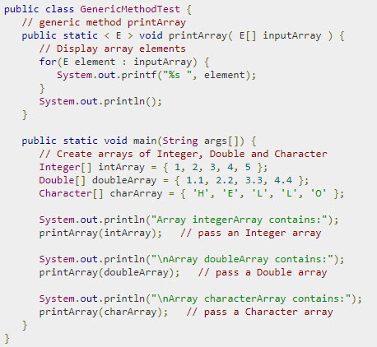
Demo generic method

Slide 16
Implementing Type-safety
To create an object of a generic class, you need to invoke the constructor of a generic class with the required type of parameters.
Java provides the flexibility to leave the type parameters empty as long as the compiler can guess or judge the type of the argument from the context.
Java provides wildcards that allow you to achieve inheritance in a type parameter.

Slide 17
Using Wildcards
In generics, a subclass cannot be passed as a subtype of a superclass, as shown in the following code snippet:
WildCardDemo<Number> obj = new WildCardDemo<Integer>();
Generics only allow the following type of declaration:
WildCardDemo<Integer> obj = new WildCardDemo<Integer>();
Or,
WildCardDemo<Number> obj = new WildCardDemo<Number>();
Some of the most commonly used wildcard arguments are:
? extends
? super
?

Slide 18
Using Wildcards (Contd.)
You can use the following code, given in the embedded document, to compare only the numeric objects:

Slide 19
Introduction to java.util package
The java.util package contains the definition of number of useful classes providing a broad range of functionality.
The package mainly contains collection classes that are useful for working with groups of objects.
It also contains a list of classes and interfaces to manage a collection of data in memory

Slide 20
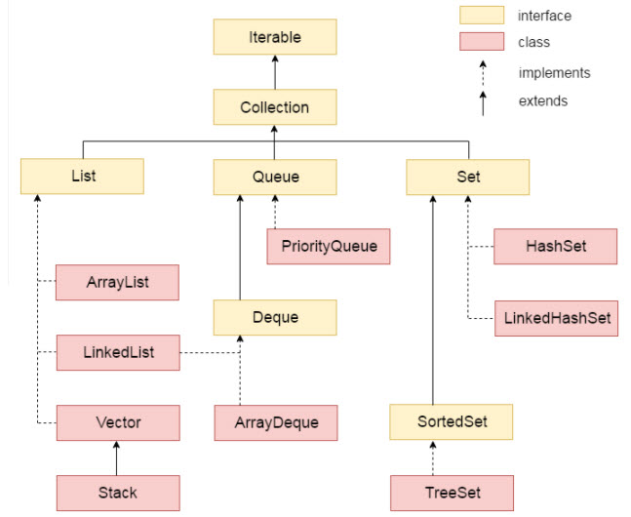
Collection Interface
Collection framework consists of interface and classes for working with group of objects.

Slide 21
Methods of Collection Interface
The important methods in the Collection interface are:
add(E obj)
contains(Object obj)
isEmpty()
size()

Slide 22
List Interface
The List interface is an extension of the Collection Interface. It defines an ordered collection of data and allows duplicate objects to be added to a list.The List interface uses an index for ordering the elements while storing them in a list.
Some methods
add(int index, Object o)
addAll(int index, Collection c)
get(int index)
set(int index)
remove(int index)
subList(int start, int end)

Slide 23
ArrayList Class
ArrayList class is an implementation of the List interface in the Collections Framework.
The ArrayList class creates a variable-length array of object references.
Array lists are created with an initial size. Later as elements are added, the size increase and the array grow as needed.
ArrayList class is suited for random access without inserting or removing elements from any place other than the end.

Slide 24
ArrayList class…
Constructors
ArrayList()
ArrayList(Collection <? Extends E> c)
ArrayList(int initialCapacity)
Methods
add(E obj)
trimToSize()
ensureCapacity(int minCap)
clear()
contains()
size()
remove(int index)

Slide 25
Vector class
The Vector class is similar to an Arraylist as it also implements dynamic array.
Vector class stores an array of objects and the size of the array can increase or decrease.
The elements in the Vector can be accessed using an integer index.
Constructors
Vector()
Vector(Collection<? extends E> c)
Vector(int initCapacity)

Slide 26
Methods Vector Class
addElement(E obj)
capacity()
toArray()
elementAt(int pos)
removeElement(Object obj)
insertElementAt(Object obj, int index)
removeElementAt(int index)
setElementAt(Object obj, int index)
firstElement()
lastElement()

Slide 27
Methods of Set Interface
The Set interface creates a list of unordered objects. It creates non-duplicate list of object references.
The set interface inherits all the methods from the Collection interface except those methods that allow duplicate elements.
Methods
containsAll(Collection <?> obj)
addAll(Collection <? extends E> obj)
retainAll(Collection <?> obj)
removeAll(Collection <?> obj)

Slide 28
SortedSet Interface
The SortedSet interface extends the Set interface and its iterator traverses its elements in the ascending order.
SortedSet is used to create sorted list non-duplicate object references.
Some of the methods in this interface are:
first()
last()
headSet(E endElement)
subSet(E startElement, E endElement)
tailSet(E fromElement)

Slide 29
Map Interface
A Map object stores data in the form of relationships between keys and values. Each key map to at least a single valule.
If key information is known, its value can be retrieved from the Map object. Keys should be unique but values can be duplicated
The Collections API provides two general-purpose Map implementation:
HashMap: is used for inserting, deleting and locating elements in a Map.
TreeMap: is used to arrange the keys in a sorted order.

Slide 30
Hashtable class
The Hashtable class implements the Map interface but stores elements as a key/value pairs in the hash table. While using a hashtable, a key is specified to which a value is linked.
The key is than hashed and then the hash code is used as an index at which the value is stored. The class inherits all the methods of the Map interface
Constructors
Hashtable()
Hashtable(int initCap)
Hashtable(int initCap, float fillRatio)
Hashtable(Map <? Extends K, ? Extends V> m)

Slide 31
The important methods of a Hashtable class
put(K key, V value)
get(Object key)
containsKey(Object Key)
containsValue(Object value)
size()
values()
keys()

Slide 32
Arrays Class
Arrays class provide a number of methods for working with arrays such as searching, sorting, and comparing arrays.
The class has a static factory method that allows the array to be viewed as lists. The methods of this class throw an exception if the array reference is null.
Methods
equals(<type>[] arraObj1, <type>[] arrObj2)
fill(<type>[] array, <type> value)
fill(<type>[] array, int fromIndex, int toIndex, type value)
sort(<type>[] array)
sort(<type>[] array, int startindex, int endIndex)
toString()

Slide 33
Summary (Contd.)
Generics enable you to generalize classes, which mean that a reference variable, an argument of a method, and a return type can be of any type.
The type parameter section is represented by angular brackets, < >, that can have one or more types of parameters separated by commas.
In the generic class, a method can use the type parameter of the class, which automatically makes the method generic.
You can declare a generic method, which contains its own one or more type parameters.
The declaration of a generic method contains the type parameter that is represented by angular brackets, < >.
java.util Packages mainly contains collection classes that are useful for working with groups of objects. It also contains a list of classes and interfaces to manage a collection of data in memory.
Sets creates a list of unordered objects or non-duplicate list of object references. It inherits all the methods from the Collection interface except those methods that allow duplicate elements.

